Slide 1
Supersaturated Design for Factor Screening
by
M. Cary
23/01/2019

Slide 2
Contents
Factor Screening & the SSD
Model Uncertainty and the Need for a Bayesian Approach
The Bayesian Concept
The Bayesian SSD Design Measure
Application to Cyclic Battery Ageing

Slide 3
Factor Screening and the SSD
Factor screening occurs early on in an investigation and attempts to determine those factors which systematically affect the response measure; i.e. are active.
Objective is to “separate the critical few from the unnecessary many”.
A supersaturated design (SSD) has more factors than runs.
An SSD is appropriate for factor screening when:
Number of factors are very large.
Data is very time consuming or expensive to collect.
An SSD can identify active factors and pareto them, so that the relevant dominance of factors on the response is revealed.

Slide 4
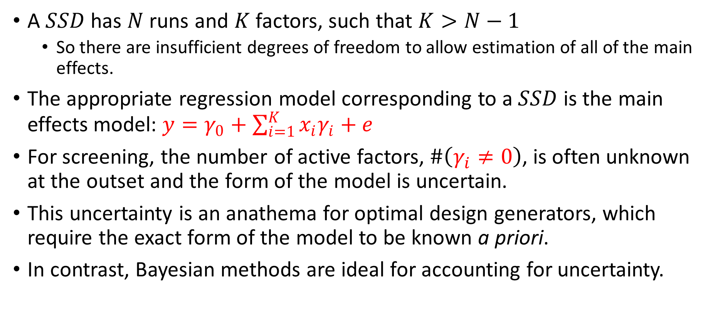
Model Uncertainty and the Need for a Bayesian Approach
A $SSD$ has $N$ runs and $K$ factors, such that $K>N−1$
So there are insufficient degrees of freedom to allow estimation of all of the main effects.
The appropriate regression model corresponding to a $SSD$ is the main effects model: $y=γ_{0}+\sum_{i=1}^{K}{x_{i}γ_{i}}+e$
For screening, the number of active factors, $\#\left(γ_{i}≠0\right)$, is often unknown at the outset and the form of the model is uncertain.
This uncertainty is an anathema for optimal design generators, which require the exact form of the model to be known a priori.
In contrast, Bayesian methods are ideal for accounting for uncertainty.

Slide 5
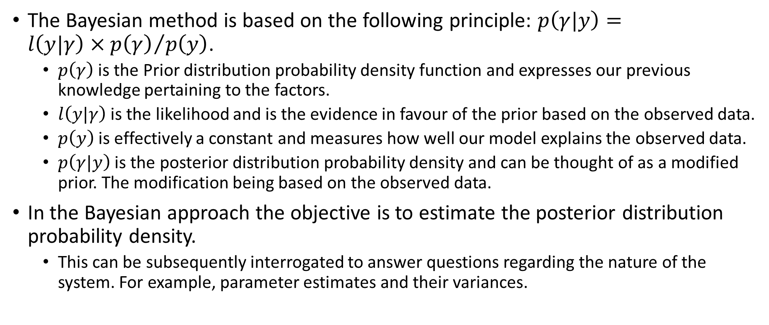
The Bayesian Concept
The Bayesian method is based on the following principle: $p\left(γ|y\right)={l\left(y|γ\right)×p\left(γ\right)}/{p\left(y\right)}$.
$p\left(γ\right)$ is the Prior distribution probability density function and expresses our previous knowledge pertaining to the factors.
$l\left(y|γ\right)$ is the likelihood and is the evidence in favour of the prior based on the observed data.
$p\left(y\right)$ is effectively a constant and measures how well our model explains the observed data.
$p\left(γ|y\right)$ is the posterior distribution probability density and can be thought of as a modified prior. The modification being based on the observed data.
In the Bayesian approach the objective is to estimate the posterior distribution probability density.
This can be subsequently interrogated to answer questions regarding the nature of the system. For example, parameter estimates and their variances.

Slide 6
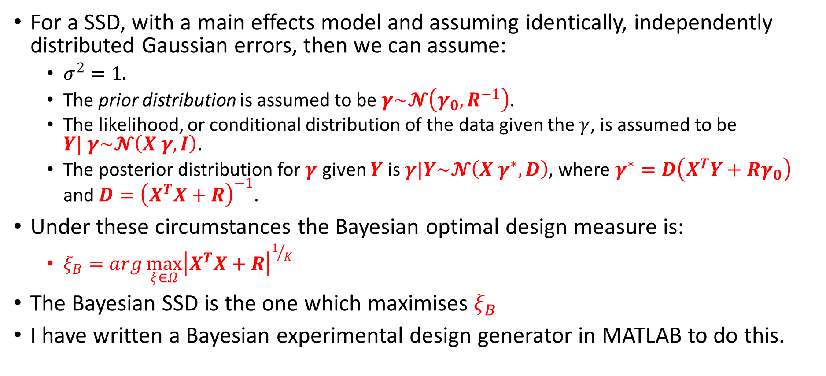
Bayesian Optimal Design Measure for SSD
For a SSD, with a main effects model and assuming identically, independently distributed Gaussian errors, then we can assume:
$σ^{2}=1.$
The prior distribution is assumed to be $γ\sim 𝓝\left(γ_{0},R^{−1}\right)$.
The likelihood, or conditional distribution of the data given the $γ$, is assumed to be $Y| γ\sim 𝓝\left(X γ,I\right)$.
The posterior distribution for $γ$ given $Y$ is $γ|Y\sim 𝓝\left(X γ^{∗},D\right)$, where $γ^{∗}=D\left(X^{T}Y+Rγ_{0}\right)$ and $D={\left(X^{T}X+R\right)}^{−1}$.
Under these circumstances the Bayesian optimal design measure is:
$ξ_{B}=arg\max_{ξ∈Ω}{{\left|X^{T}X+R\right|}^{1/K}}$
The Bayesian SSD is the one which maximises $ξ_{B}$
I have written a Bayesian experimental design generator in MATLAB to do this.

Slide 7
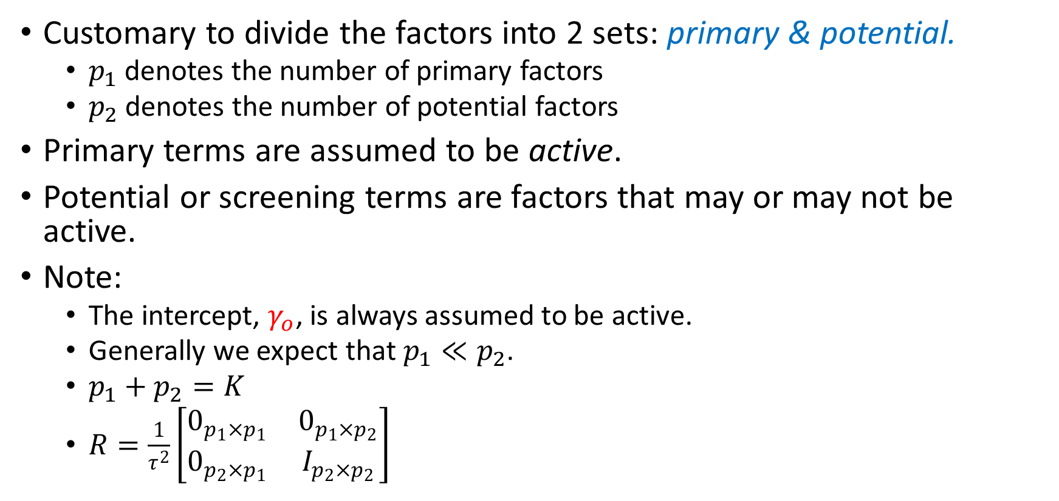
Primary and Potential Factors
Customary to divide the factors into 2 sets: primary & potential.
$p_{1}$ denotes the number of primary factors
$p_{2}$ denotes the number of potential factors
Primary terms are assumed to be active.
Potential or screening terms are factors that may or may not be active.
Note:
The intercept, $γ_{o}$, is always assumed to be active.
Generally we expect that$p_{1}≪p_{2}$.
$p_{1}+p_{2}=K$
$R=\frac{1}{τ^{2}}\left[\begin{matrix}0_{p_{1}×p_{1}} & 0_{p_{1}×p_{2}} \\ 0_{p_{2}×p_{1}} & I_{p_{2}×p_{2}}\end{matrix}\right]$

Slide 8
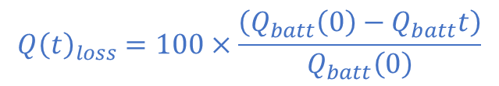
Application to Cyclic Battery Ageing
The time scales associated with battery (EoL) determination suggest that efficient factor screening protocols are required.
I propose demonstrating the use of a SSD to screen factors for battery cycling ageing data.
7-factors in 6 runs.
Test Plan
Factors
Properties
Response
$${Q\left(t\right)}_{loss}=100×\frac{\left(Q_{batt}\left(0\right)−Q_{batt}t\right)}{Q_{batt}\left(0\right)}$$

